Slide 1


Bank of Baroda Hackathon - 2022
Technology Partner
Your Team Name : Virtual Bot
Your team bio : Developing Probleming solving Virtual Assistant Bots.
Date :20/09/2022

Slide 2
Problem Statement?
Why did you decide to solve this Problem statement?
Banking plays a cructial role in the financial life of every indivudual and as everything gets digitalized these days, the need for making it user friendly for all the people including people with no knowledge in technology also arises , this is where our idea evolves.
We develop a Virtual Assistant Bot which can understand multiple languages in the natural form, process it and give back in the same language in a humanly voice.
This also evokes a feel of security and control over their accounts -
In simple words a
“A banking for all in their own comfort “.

Slide 3
Problem Statement?
Why did you decide to solve this Problem statement?
If they can’t understand the process of banking ,this idea can help even rural people to adapt to the concept of banking easily through their smart phones, which makes it efficient and completely user friendly as they can bank in their own language.
Voice-enabled banking virtual assistants can handle
a) payments and transfers
b) credit card activation
c) password reset
d) pay alerts and reminders for customers anytime and from anywhere
e) freeing up customer services teams to focus on more complex customer enquiries and enhance productivity.

Slide 4
User Segment & Pain Points
Which user /advertiser segment would be early adopter of your product & why?
Banking Sector would most sought this product because it provides a lot of enhanced features than other Cloud Computing Services with AI. It uses AZURE AI API’s and it provides comprehensive algorithm support with a sensible pricing . Azure AI is seamless and faster web service deployment and other key features for choosing it is as follows:
Speed
Enhanced flexibility
Integrated delivery pipeline
Disaster recovery
Security

Slide 5
Pre-Requisite
What are the alternatives/competitive products for the problem you are solving?
Curentlly the top Virtual Assistant bots in the banking sector are EVA which was the first VA in India developed in India in 2017 and was a success since then , it has a accuracy of 85% and handles 20,000 coversations a day and it is powered by AI and NPL .
Similarly, SIA developed by SBI bank is also a productive chatbot with a capabality to handle 10,000 enquiries per second and can also respond to voice or text in 14 languages.

Slide 6
Azure tools or resources
Azure tools or resources which are likely to be used by you for the prototype, if your idea gets selected 1. Speech to Text 2. Text to Speech 3. Language Translation 4. Speech Services in Action 5. Natural Language Processing 6. Conversational AI

Slide 7
Any Supporting Functional Documents
Present your solution, talk about methodology, architecture & scalability
We will develop an AI based Virtual Assistant Chat bot for all banking needs.
The Voice Assistant understands NLP (Natural Language Processing) and can understands upto 5 lanugages namely English ,Tamil, Hindi ,Telegu ,Kannada and also reply in the same languages back .
And with the help of Sentiment Analysis , It will identify the true intent of the conversation.
And all the transactions will be protected through industry standard privacy and security features.

Slide 8
Any Supporting Functional Documents
Present your solution, talk about methodology, architecture & scalability
In our voice assistant, in order to create a better client experience, anticipate the conversation's course and prepare solutions in advance.
Every consumer touchpoint, including the web, online banking, apps, and interactive voice response, will be supported by the Virtual Assistant.
And to make it even more simpler and friendly to users we use emojis in the in basic and feedback part, so that anyone can understand and respond, even people with no reading knowledge.

Slide 9
Key Differentiators & Adoption Plan
How is your solution better than alternatives and how do you plan to build adoption?
Our Virtual Assistant stands out from the other by a lots of new features and factors, starting from security, it is crucial to have security and have control over one’s possession, we implement PIN for security verification in each stages of processing even in the VA.
Another major drawback of VA till now, is the error with the voice recognition which in turn leads to bad user experience for many customers and also late replies from the voicebots , these issues willl be sorted in our solution and the voice bot processing time will take seconds to complete it.

Slide 10
Key Differentiators & Adoption Plan
How is your solution better than alternatives and how do you plan to build adoption?
Virtual Assistant ( VA ) will be able to detect fraud and scams by working as per the criteria given in the algorithm.
And also it will be able to process large data without any lags or delays, which in the existing bots led to major problems like shutdown of the server leading to inconvenience.
And another small and central feature is that we use emojis to get replies in every possible way starting from feedback at the end of the process, as Emoji is the visual representation and can be universally understood it will be very beneficial .

Slide 11
Key Differentiators & Adoption Plan
How is your solution better than alternatives and how do you plan to build adoption?
All the above tools are used to recognize tha account holder able to identify their voice and language and to be able to convert the text to speech.
Apart from that we will be adding a few security details like both Fingerprint and PIN as modes of accesing and processing for people with every level of technology and also we are going to focus on the major operations like Loan procedure , FD Deposit and other basic and advanced banking features and as a additional like adding Emojis as a reply option in certain processes.

Slide 12
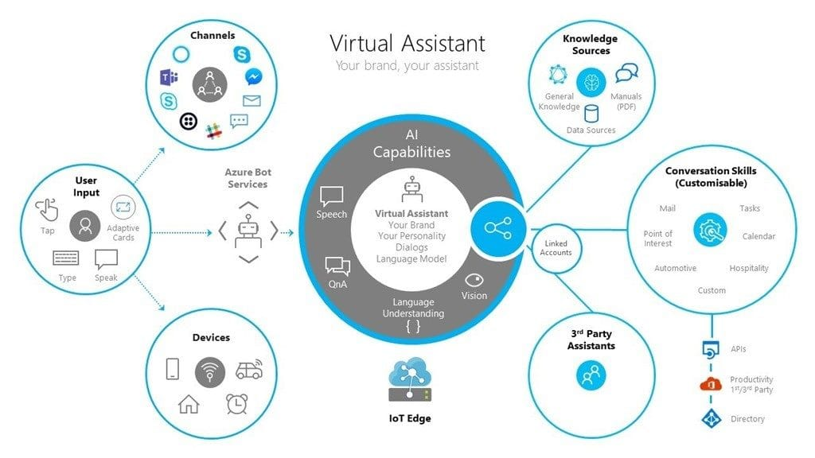

GitHub Repository Link & supporting diagrams, screenshots, if any
Github Repository https://github.com/GEEKTECHE/Virtual-Assistant

Slide 13
Thank You
TEAM MEMBERS :
HEMANTH S
N NAGACHAND

